Slide 1
Milestone 2: Determined Mail
TBD: Ian, Halle, Sophia, Leigh
Notes:
HALLE

Slide 2
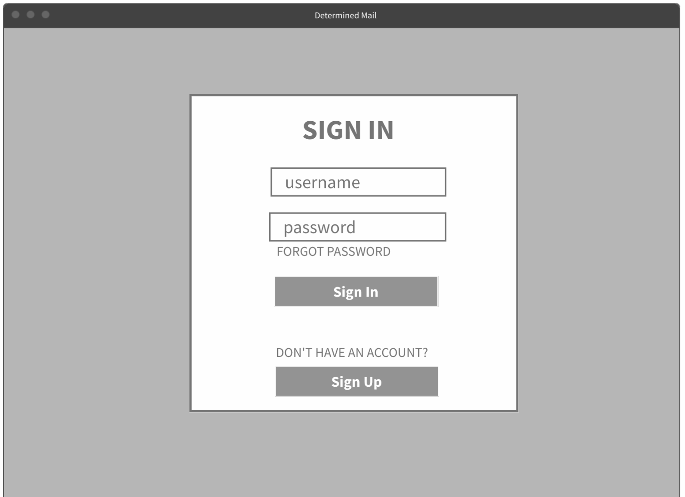
Notes:
LEIGH

Slide 3
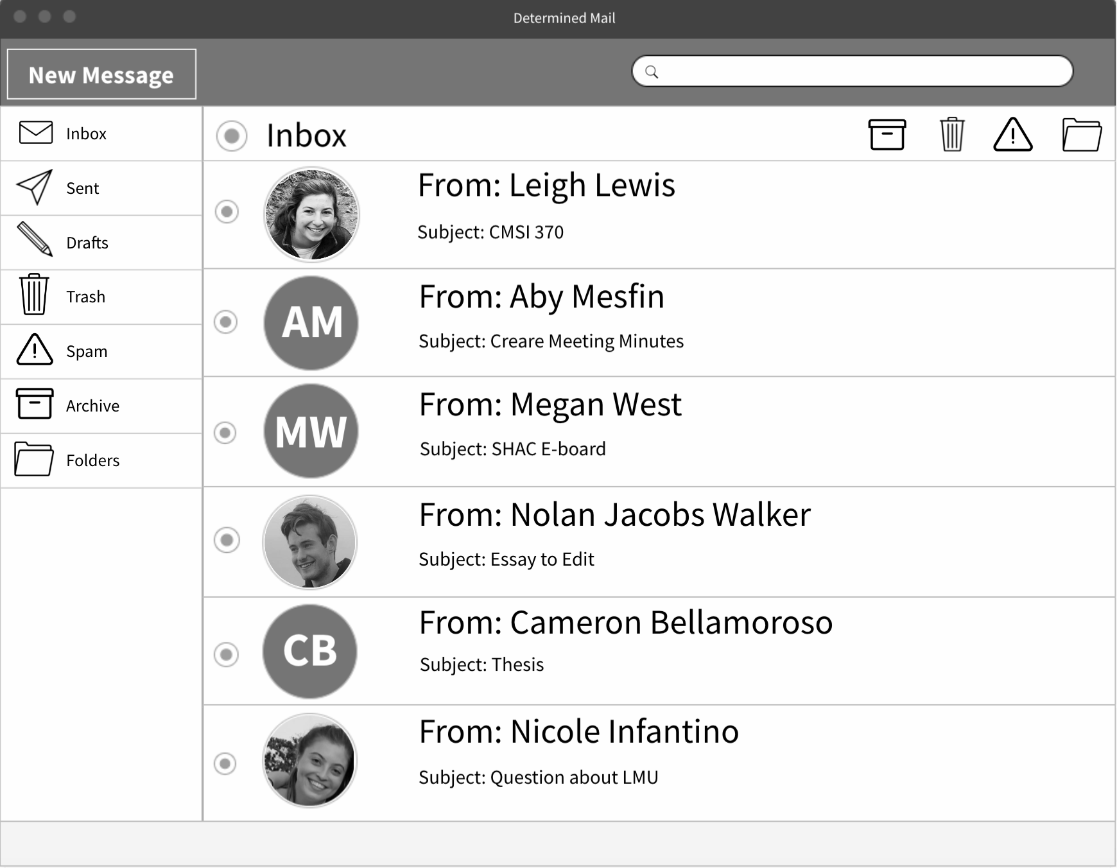
Notes:
LEIGH

Slide 4
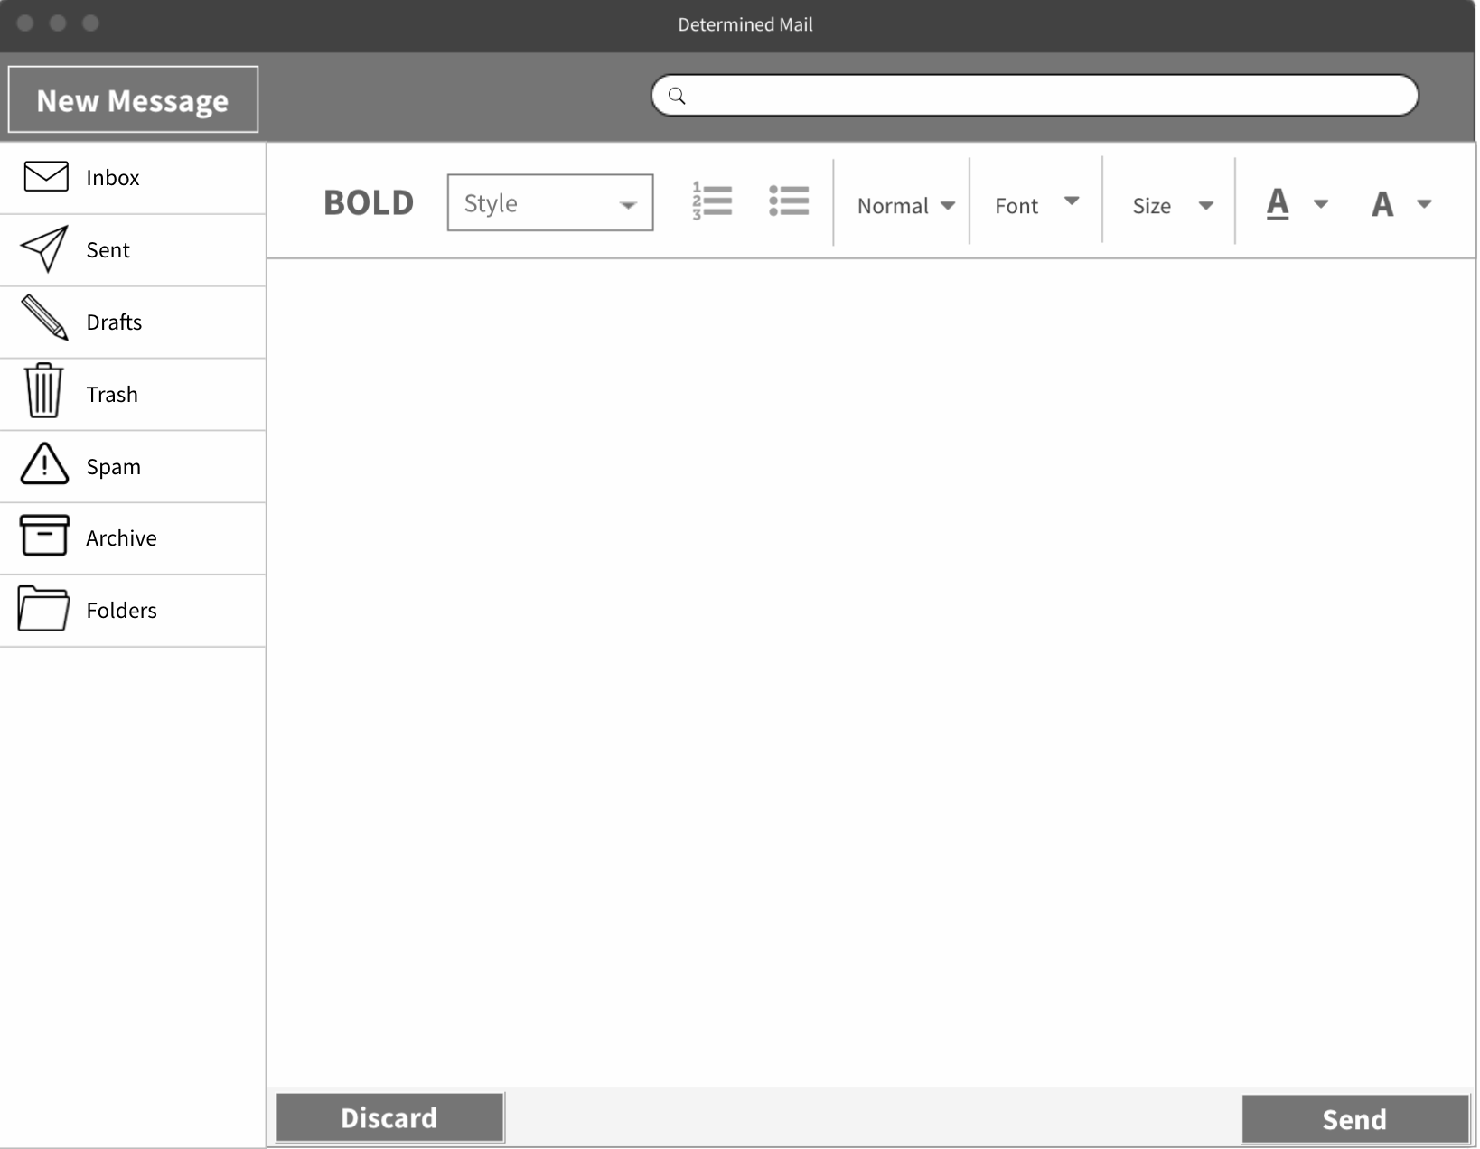
Notes:
LEIGH

Slide 5
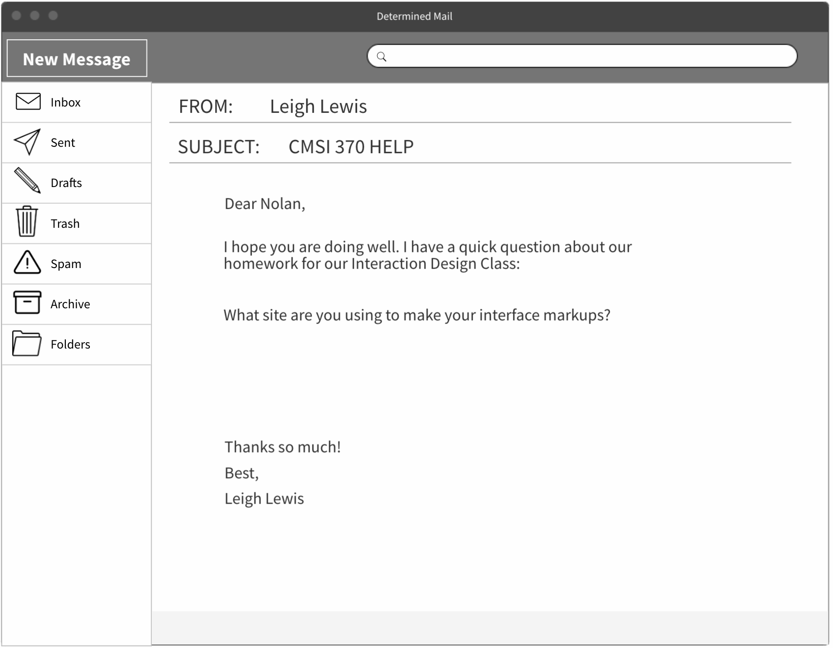
Notes:
LEIGH & HALLE (Strengths and Weaknesses)

Slide 6
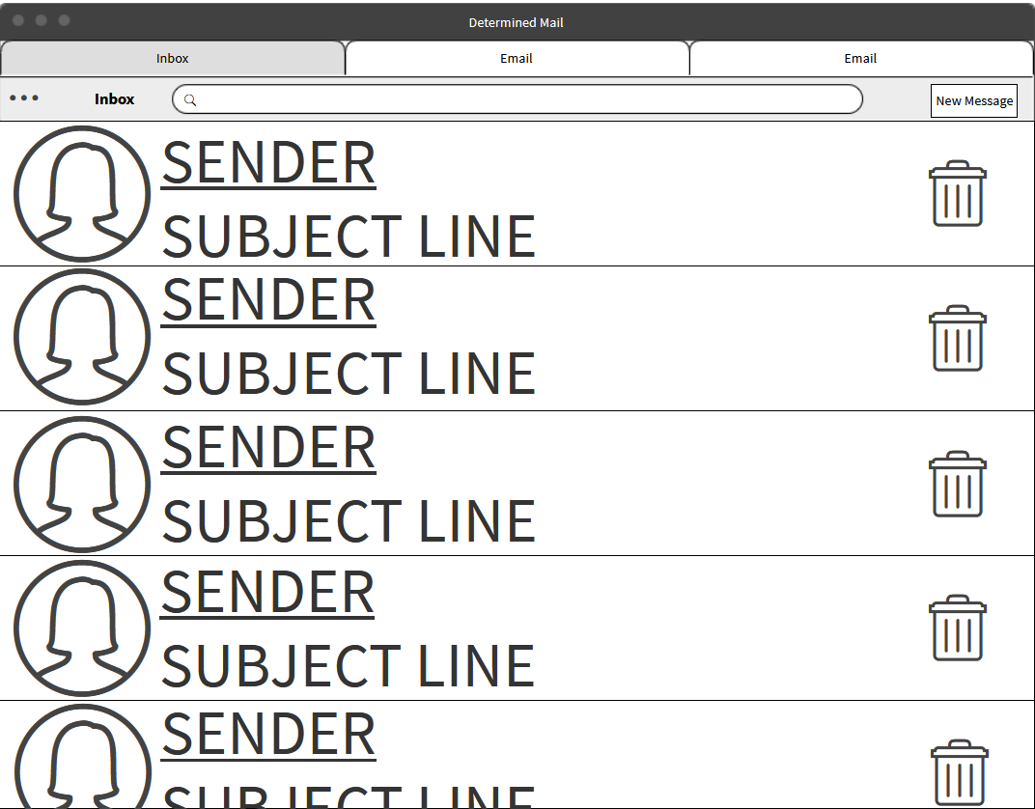
Notes:
IAN

Slide 7
Notes:
IAN

Slide 8
Notes:
IAN

Slide 9
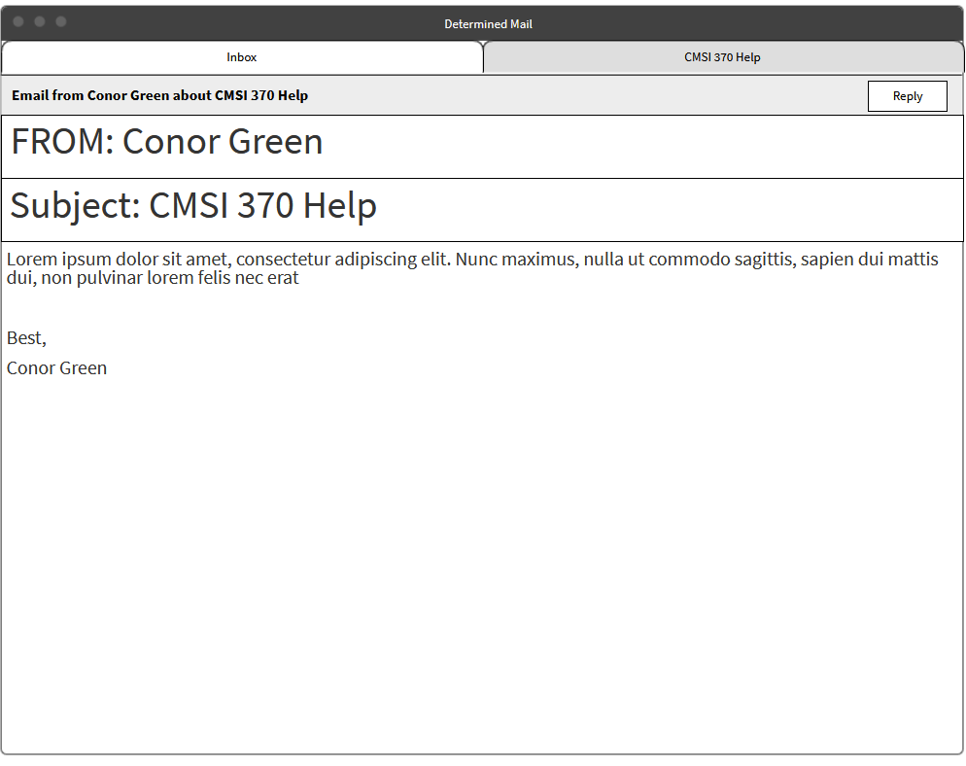
Notes:
IAN
Strengths/Weaknesses

Slide 10
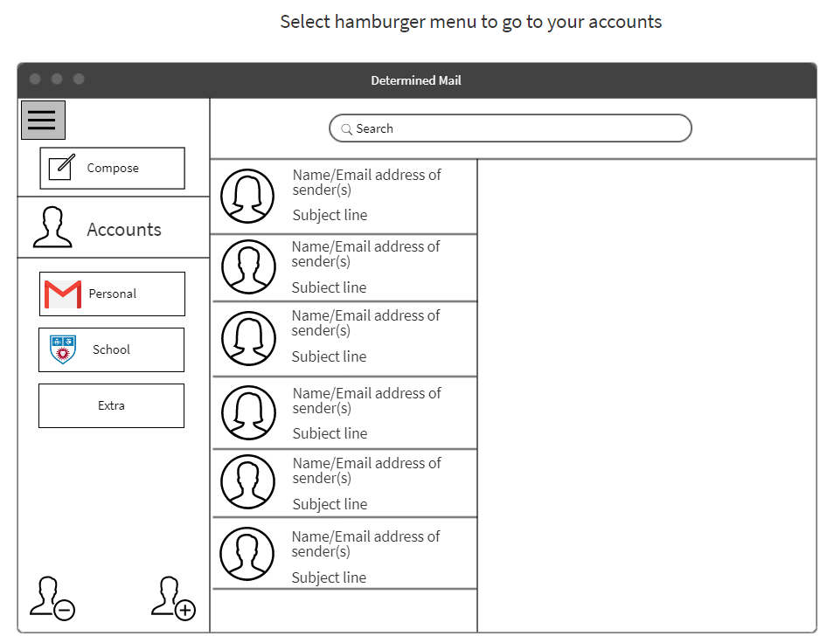
Notes:
SOPHIA

Slide 11
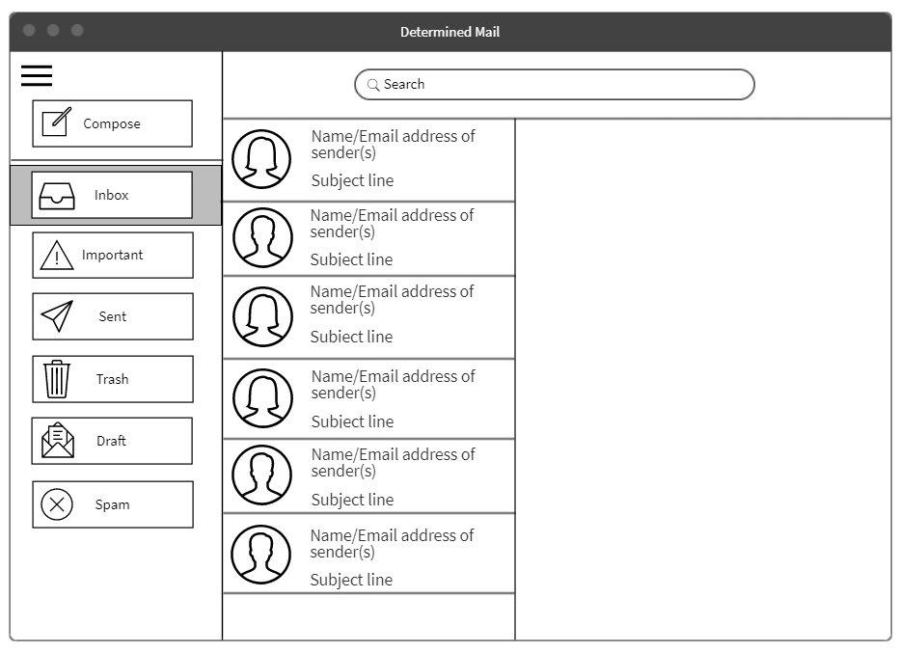

Slide 12
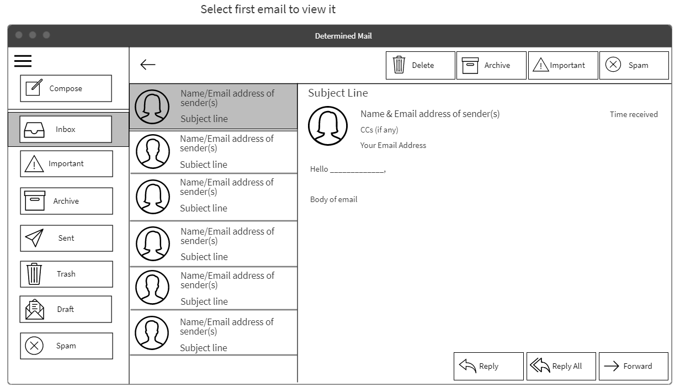
Notes:
SOPHIA

Slide 13
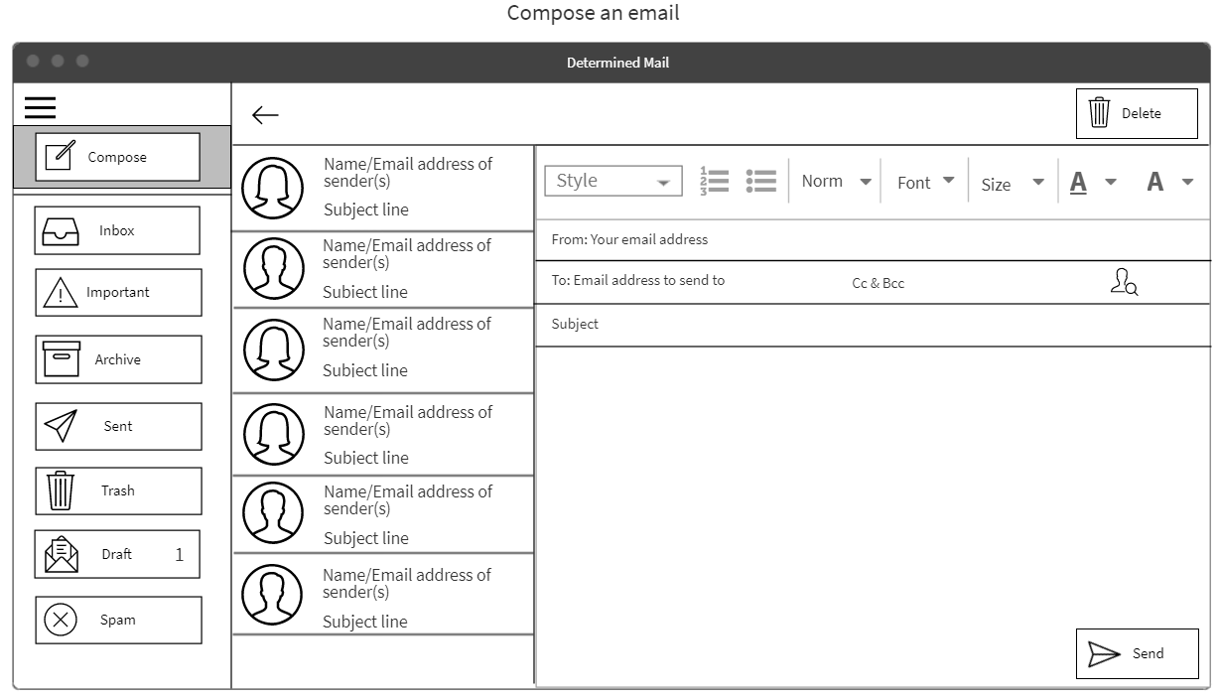
Notes:
SOPHIA & HALLE (Strengths and Weaknesses)

